Slide 1
Chapter VI
OpenGL ES and Shader

Slide 2
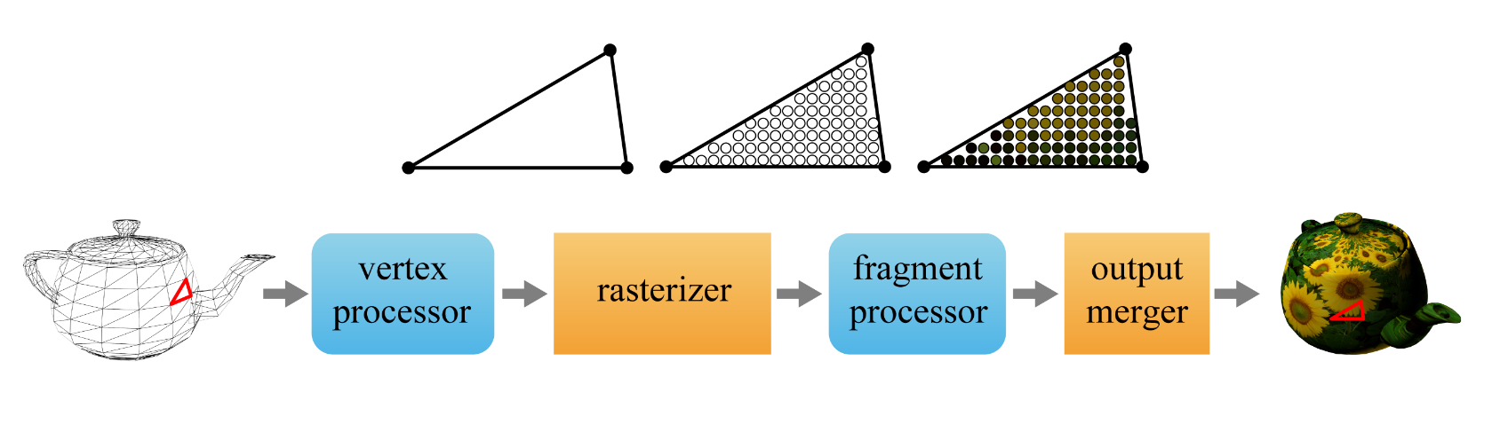

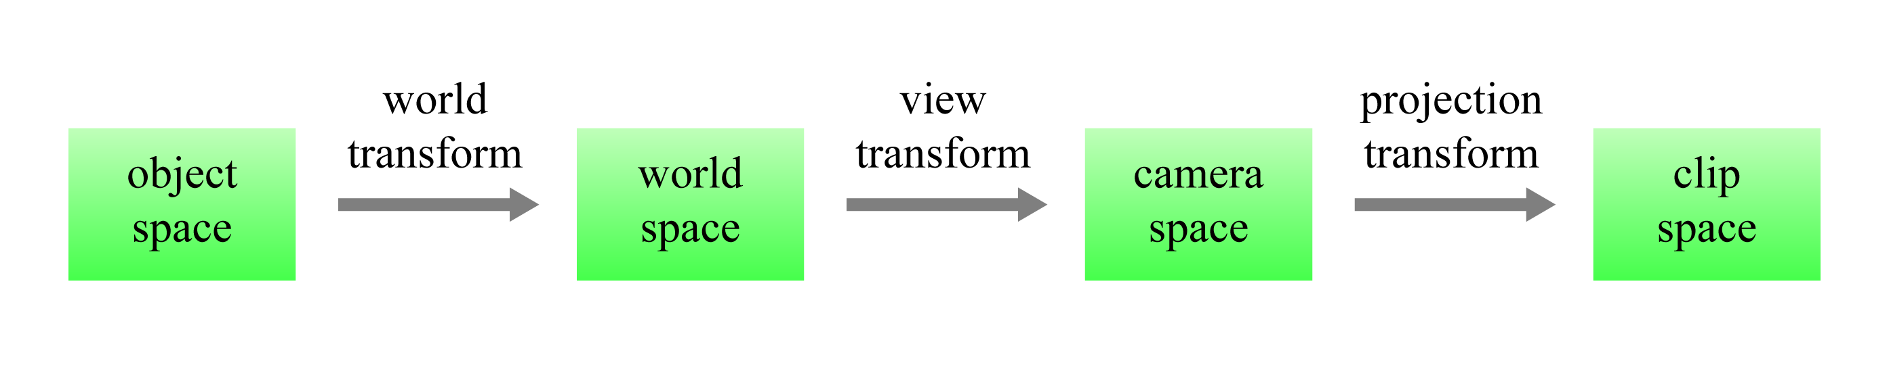
GPU Rendering Pipeline (revisited)
Main stages in the rendering pipeline
The vertex shader (vertex program) operates on every input vertex stored in the vertex array and performs various operations.
The essential among them is applying a series of transforms to the vertices.
6-<number>

Slide 3
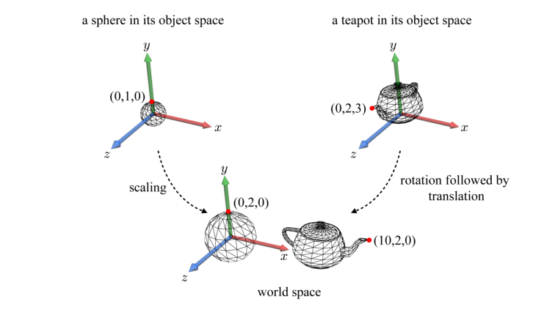
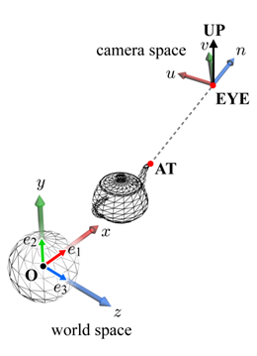
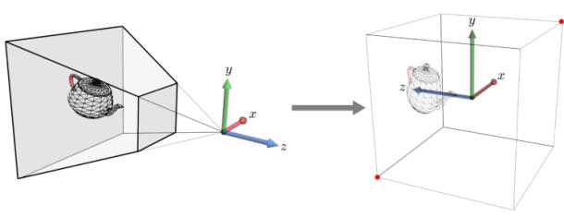
Spaces and Transforms (revisited)
object 1
(object space 1)
object 2
(object space 2)
object 3
(object space 3)
…
object n
(object space n)
world transform 1
world transform 2
view
transform
projection
transform
scene
(world space)
scene'
(camera space)
scene''
(clip space)
world transform 3
world transform n
The same world transform is applied to all vertices of an object.
Each object has its own world transform, but all objects share the view and projection transforms.
6-<number>

Slide 4
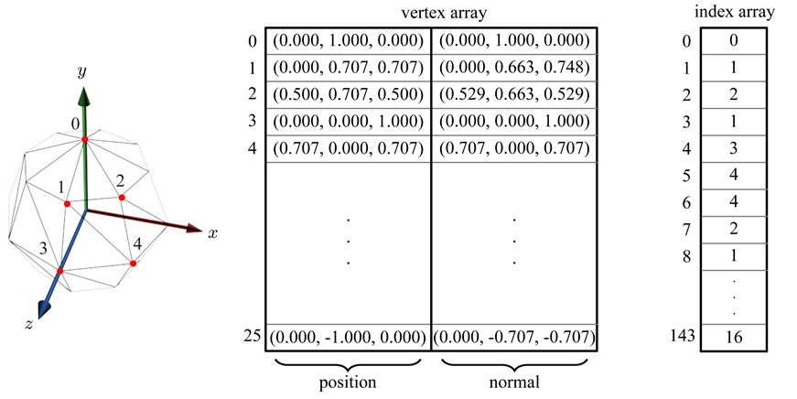
Vertex and Index Arrays (revisited)
The indispensible components of vertex array are position, normal, and texture coordinates. Texture coordinates are 2D and used to access the 2D texture. (This is presented at CH 8.)
Conceptually, the vertex shader processes a vertex (an element) of the vertex array at a time.
tex coord
6-<number>

Slide 5
OpenGL ES
OpenGL ES is a subset of OpenGL.
  OpenGL ES 2.0 is derived from OpenGL 2.0 and provides vertex and fragment shaders.
  OpenGL ES 3.0 is derived from OpenGL 3.3 and adds many enhanced features to OpenGL ES 2.0.
  OpenGL ES 3.1 (publicly released in March 2014) includes compute shaders.
  OpenGL ES 3.2 (August 2015) includes geometry and tessellation shaders.
OpenGL ES 3.0 is backward compatible with OpenGL ES 2.0, i.e., applications built upon OpenGL ES 2.0 work with OpenGL ES 3.0.
This class focuses on OpenGL ES 3.0.
  OpenGL ES 3.0 API specification
  OpenGL ES Shading Language Specification
From now on, let’s call OpenGL ES simply ‘GL’ and OpenGL ES Shading Language by ‘GLSL.’
6-<number>

Slide 6
OpenGL ES Shading Language
GLSL is a C-like language. For example, float is supported.
However, GLSL works on GPU, the goal and architecture of which are different from those of CPU. The differences shape GLSL in a distinct way.
Vector and matrix examples
  vec4 defines a floating-point 4D vector and ivec3 defines an integer 3D vector.
  mat3 and mat4 define 3x3 and 4x4 ‘square’ matrices, respectively, whereas mat3x4 is for a 3x4 matrix. The matrix elements are all float values.
6-<number>

Slide 7
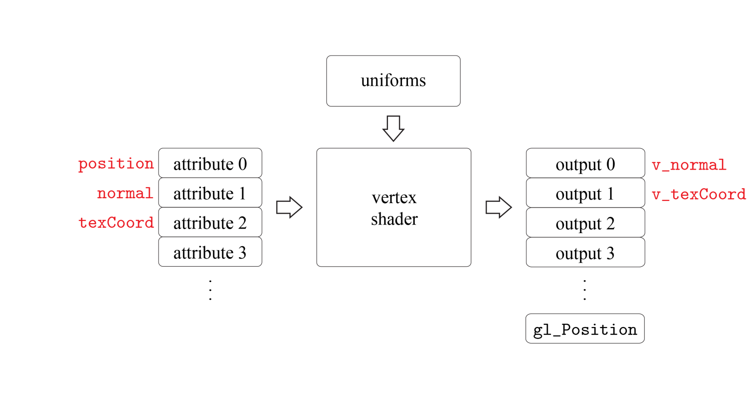
Vertex Shader
A vertex shader per object!
Two major inputs
  Attributes: The per-vertex data stored in the vertex array such as position.
  Uniforms: The per-object data that remain constant for multiple executions of a shader, e.g., world matrix.
Outputs
  They must include the built-in variable, gl_Position, which stores the clip-space vertex position.
  In addition, they usually include normal and texture coordinates.
6-<number>

Slide 8
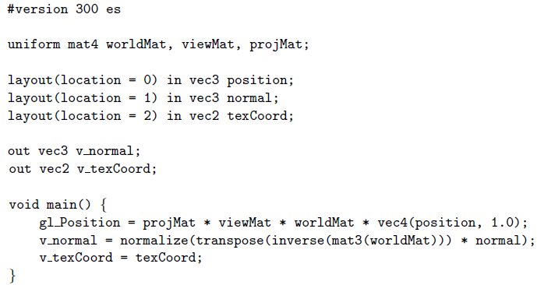
Vertex Shader (cont’d)
Our first vertex shader
The attributes are preceded by the keyword, in. The optional layout qualifiers such as layout(location = 0) specify the attribute locations.
The output variables are preceded by the keyword, out.
out.
6-<number>

Slide 9
GL Program
The fragment shader is written in a similar fashion.
While the vertex and fragment shaders are in charge of low-level details in rendering, the role of GL program itself is managing the shaders and various data needed for the shaders.
GL API
  GL commands begin with the prefix gl.
  GL data types begin with the prefix GL.
6-<number>

Slide 10

GL Program - Shader Object
Given a vertex shader stored in a file, we do the following:
  A shader object is created using glCreateShader, which takes either GL_VERTEX_SHADER or GL_FRAGMENT_SHADER and returns the unsigned integer ID of the shader object.
  Assuming that the shader’s source code is loaded into the GL program and is pointed to by source, which is of type char*, the source code is stored in the shader object by glShaderSource.
  The shader object is compiled using glCompileShader.
The same process has to be done for the fragment shader using GL_FRAGMENT_SHADER for glCreateShader.
Now you have two shader objects (for the vertex and fragment shaders).
6-<number>

Slide 11

GL Program - Program Object
The shader objects (for the vertex and fragment shaders) should be attached to a program object, which is then linked to the final executable.
  The program object is created by glCreateProgram, which takes no argument and simply returns the ID of the new program object.
  The vertex and fragment shader objects are attached to the program object by glAttachShader.
  The program object is linked by glLinkProgram.
  So as to use the program object for rendering, glUseProgram is invoked.
program object
vertex shader object
fragment shader object
6-<number>

Slide 12
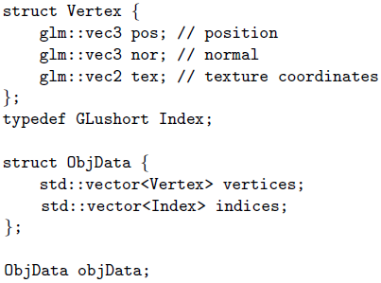
Attributes
  The GL program not only hands the attributes over to the vertex shader but also informs the vertex shader of their structures.
  Suppose that the polygon mesh data stored in a file (such as a .obj file) are loaded into the vertex and index arrays of the GL program and they are pointed to by vertices and indices, respectively. The arrays are stored in objData.
  glm stands for OpenGL Mathematics. It is a library that provides classes and functions with the same naming conventions and functionalities as GLSL.
6-<number>

Slide 13
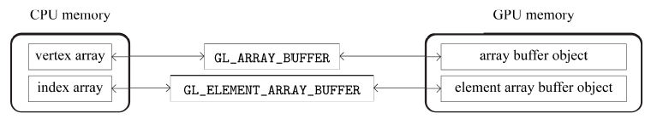
Attributes (cont’d)
The vertex and index arrays residing in the CPU memory will be transferred into the buffer objects in the GPU memory.
For the indexed representation of a mesh, GL supports two types of buffer objects:
  Array buffer object is for the vertex array and is specified by GL_ARRAY_BUFFER.
  Element array buffer object is for the index array and is specified by GL_ELEMENT_ARRAY_BUFFER.
6-<number>

Slide 14
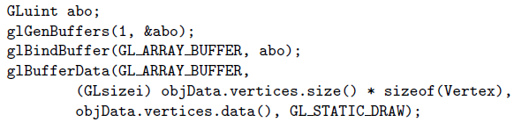
Attributes (cont’d)
Creating and binding buffer objects
  The buffer object is created by invoking glGenBuffers(Glsizei n, Gluint *buffers), which returns n buffer objects in buffers.
  The buffer object is bound to the vertex array by invoking glBindBuffer with GL ARRAY BUFFER.
  In order to fill the buffer object with objData.vertices, glBufferData is invoked.
6-<number>

Slide 15
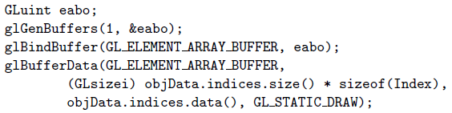
Attributes (cont’d)
The same process is done for the index array.
6-<number>

Slide 16
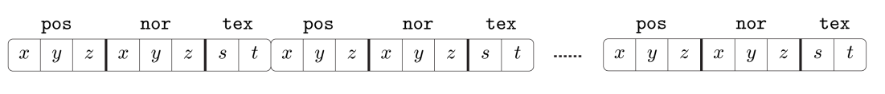
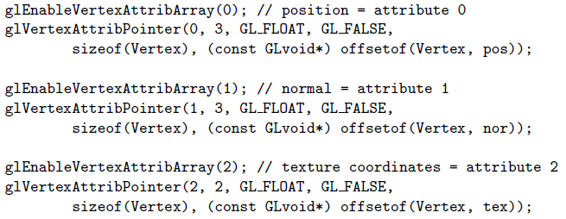
Attributes (cont’d)
  Vertex attributes in the buffer object
  The GL program uses glEnableVertexAttribArray and glVertexAttribPointer to inform the vertex shader of such a structure.
stride
6-<number>

Slide 17
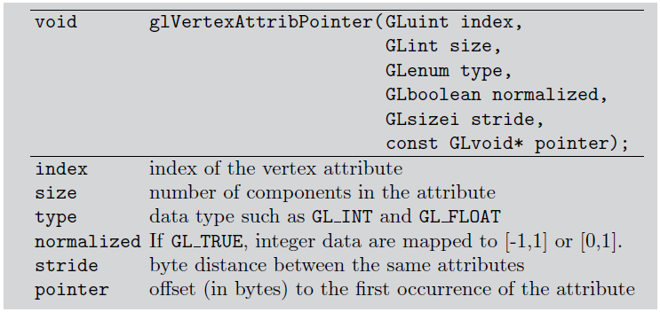
Attributes (cont’d)
6-<number>

Slide 18

Uniforms
Our vertex shader has three uniforms: worldMat, viewMat, and projMat.
Consider a dynamic environment.
  If the scene object moves, worldMat should be changed.
  If the viewpoint moves, viewMat should be changed.
The GL program updates and provides them for the vertex shader.
For this, we first invoke glGetUniformLocation to find the uniform’s ‘location’ in the program object, which was determined during the link phase.
Suppose that the GL program computes the world matrix and names it worldMatrix. In order to assign worldMatrix to the vertex shader's uniform, worldMat, we invoke glUniformMatrix4fv, where 4 indicates a 4x4 matrix, f indicates that its elements are floating-point values, and v implies that the values are passed in a vector, i.e., an array:
6-<number>

Slide 19
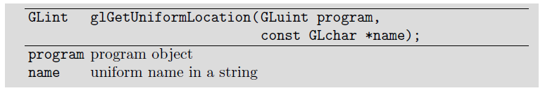
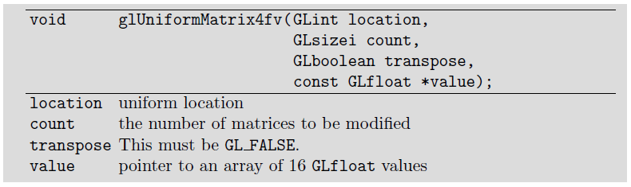
Uniforms (cont’d)
6-<number>
Notes:
Any parameter to a shader that is “constant across either all vertices or fragments” (but that is not known at compile time) should be passed in as a uniform.

Slide 20
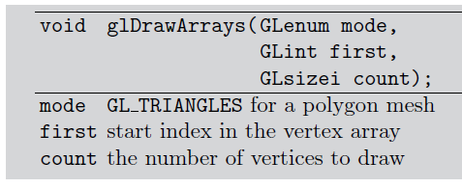
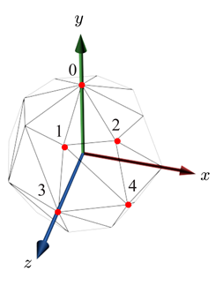
Drawcalls
We have made all attributes and uniforms available.
Suppose that we have a good fragment shader, whatever it is.
Then, we can draw a polygon mesh.
For rendering a polygon mesh, we can make a drawcall.
  glDrawArrays for non-indexed mesh representation
  glDrawElements for indexed mesh representation
48 triangles
6-<number>

Slide 21
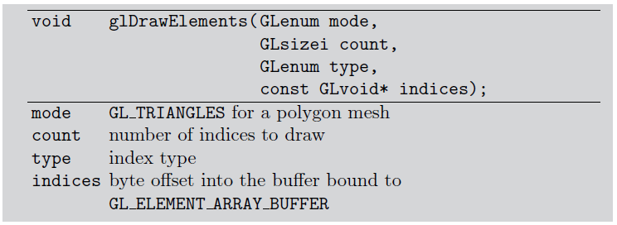
Drawcalls (cont’d)
For indexed representation:
6-<number>

